Slide 1
The iTronics Group Inc.
Robotics and Artificial Intelligence Startup !!!
www.theitronics.com

Slide 2
Our Vision
Use Robotics and Artificial intelligence to build the future

Slide 3
Field Mastered
1
Robotics and Artificial Intelligence
We are mastering different useful tech Skills as:
2
Data Science and Business Intelligence
3
Web and Application Development
4
Project Management

Slide 4


Our Projects
Our “Problem solver” mindset helps us to work on scalable projects:
Projects:
We have more than ten (10) projects, but we’ll present you below our top Four (04) Projects:
MAN NO RUN
GAMBA
CNCFA
ASSO
Patron textile
The road security system (Traffic light security system)
The Smart House
(Home with automated and intelligent systems)
Manufacture CNC machines in Africa and supply the world.
Artificial intelligence to translate mother languages
Industrial production and distribution of textiles in Africa

Slide 5
Our Services
Embedded system and IoT
Web and Mobile Development
Your Pub Panel, Your electronics and your internet of things devices are our care.
We build and maintain your website and all your digital marketing tools.
Security Camera and devices
Data Analysis
We can secure your house, your company or your warehouses
We help your take a decision based on your data.
Domestic electricity and Domotics
Project Driving
Your domestic electricity installation with remote control devices.
We are available to drive each of your Projects.
Renewable energy (Solar panel)
NFC technology integration
Designing and installing solar power plant.
We are integrating NFC technology on your Projects.

Slide 6
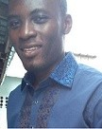
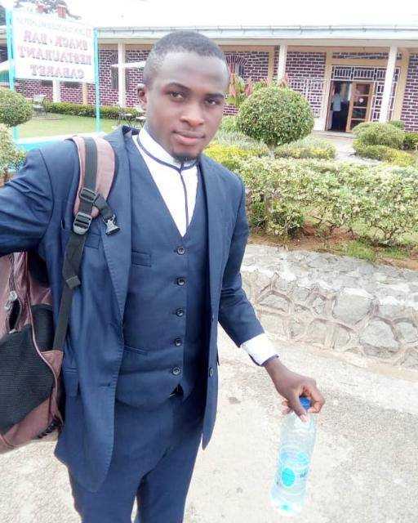
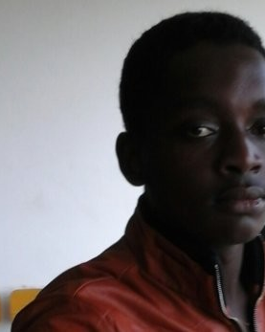
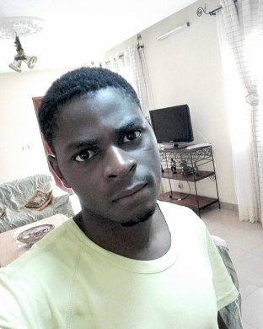
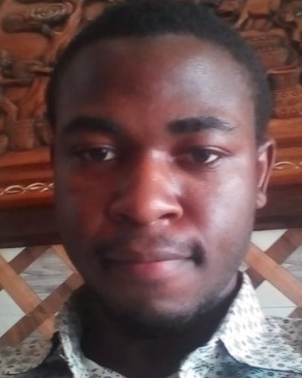
Our Team Layout
Steve Moneyang
Ngube Hermann
RomaricTsopnang
Jaures Ndoumbe
Joskel Tagueu
Engineer
Engineer
CEO
Programmer
Programmer
Industrial Automation and Embedded systems Expert.
Data Scientist and Mobile App developer.
Artificial Intelligence and Robotics Expert.
Desktop and Cross Platform app developer.
Full Stack developer and PhD candidate.

Slide 7
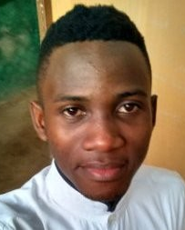
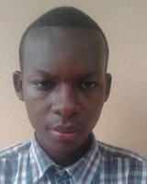
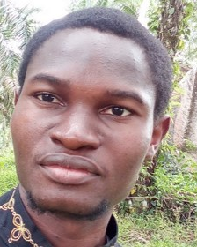
Our Team Layout
Colbert Mbiada
Jude Sinjeh
Aristide Ziem
Programmer
Programmer
Engineer
Electronics circuits Enthusiast.
Full stack Developer.
Renewable energy Expert and textile consultant.

Slide 8
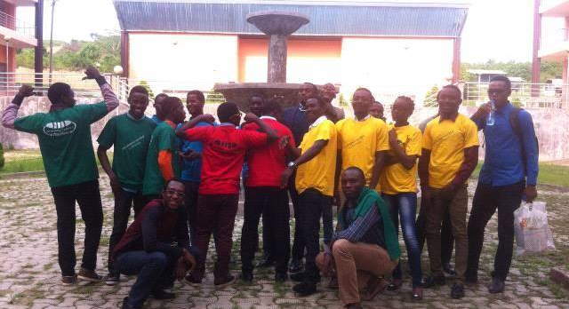
The iTronics
Team Presentation

Slide 9
Our Events
Embedded system Workshops
Inviting people to work with PIC microcontrollers, Arduino on Projects.
Internet of things Workshops
Inviting people to work on IoT devices with Raspberry Pi and ESP8266.
Arduino Day Workshops
Organizing international event and bringing together all Cameroon’s innovators to work on same platform.
Artificial Intelligence Workshops
Sensitizing people on the importance of AI and helping them to build Project with it.

Slide 10
TimeLine Layout
Organizing Embedded system workshops. Organizing Arduino Day 2016.
Organizing Arduino Day 2018.
Creating The iTronics Startup.
2019
2016
2018
2015
2017
Getting one of our Projects funded.
Creating “The iTronics” Community.
Organizing Internet of things workshops. Organizing Arduino Day 2017

Slide 11
Thank you
The Technology is there !!!

Slide 12
Fully Editable Icon Sets : A
You can Resize without losing quality
You can Change Fill Color &
Line Color
FREE
PPT TEMPLATES
www.allppt.com

Slide 13
Fully Editable Icon Sets : B
You can Resize without losing quality
You can Change Fill Color &
Line Color
FREE
PPT TEMPLATES
www.allppt.com

Slide 14
Fully Editable Icon Sets : C
You can Resize without losing quality
You can Change Fill Color &
Line Color
FREE
PPT TEMPLATES
www.allppt.com

